Slide 1

MicrobeTrace Tutorial for COVID-19 Data
Ellsworth Campbell
Anupama Shankar
Bill Switzer
Molecular Epidemiology and Bioinformatics Team
Laboratory Branch, Division of HIV and AIDS Prevention
National Center for HIV, Hepatitis, STD and Tuberculosis Prevention

Slide 2
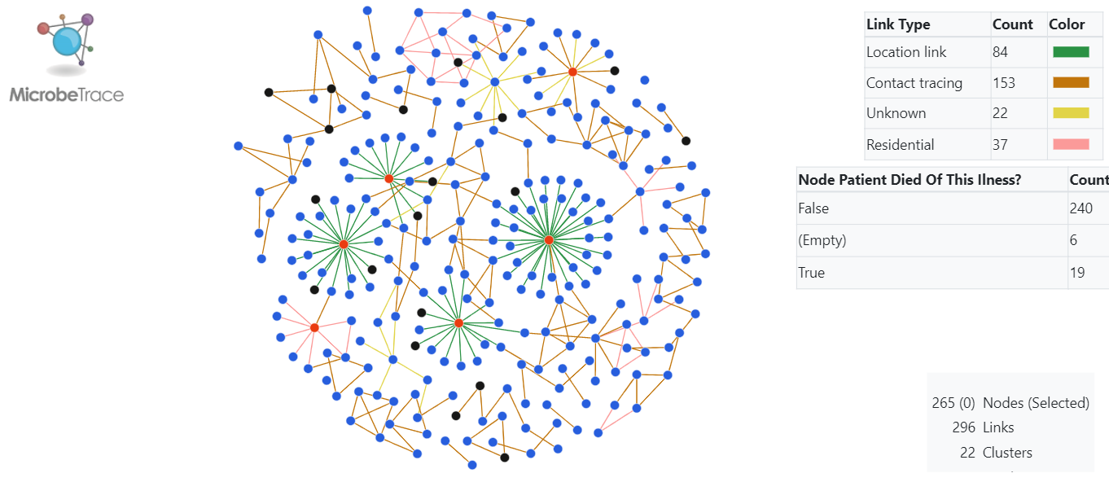
Introduction to MicrobeTrace
A powerful, secure, user-friendly data visualization tool
Handles various input files:
edge lists (contact tracing data),
node lists (demographic data),
sequence data (FASTA, distance matrices, phylogenetic trees)
Multiple visualization options to effectively process and view COVID-19 data
Access MicrobeTrace at https://microbetrace.cdc.gov/MicrobeTrace/​
Full-length tutorial webinar https://youtu.be/5E-_Kb7yvHU

Slide 3
Tutorial outline
Example files with simulated COVID data
Accessing MicrobeTrace and loading files
Navigating MicrobeTrace:
2D Network View
Map View
Histogram View
Gantt View
Flow Diagram View
Tiled Views
Where to find help

Slide 4
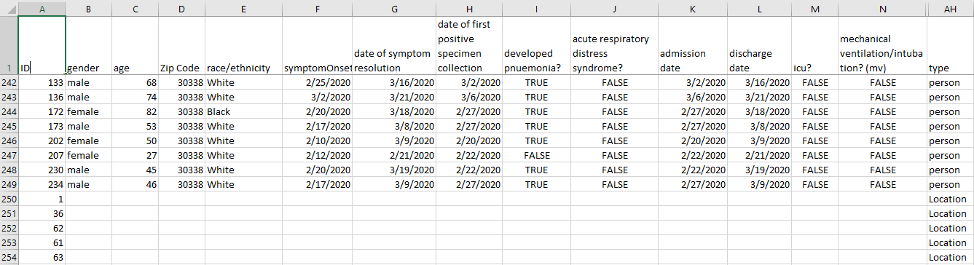
Example files: node list and edge list
The following 2 files contain simulated COVID data created for training purposes to demonstrate the utility of MicrobeTrace for this use case scenario.
Node list: nodeList_covidDummy.csv
Contains a single row for each case that describes demographic, clinical symptom, and comorbidity data. Some nodes are persons (e.g., 230, 234, etc.); some nodes are places to enable person place network analyses (e.g., 61, 62, etc.)

Slide 5
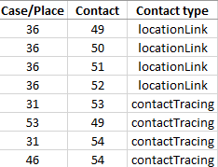
Example files: edge list
Edge list: edgeList_covidDummy.csv
Contact tracing list; each row represents a report of potential exposure between a case and their contact. The edge can be from a person or a place. The contact type can be a person-to-person link (e.g. case 31 to case 53) or a
place-person) link, e.g. place 36 to contact 50).
36 is a place node,
50 is a person node
31 and 53 are person nodes

Slide 6
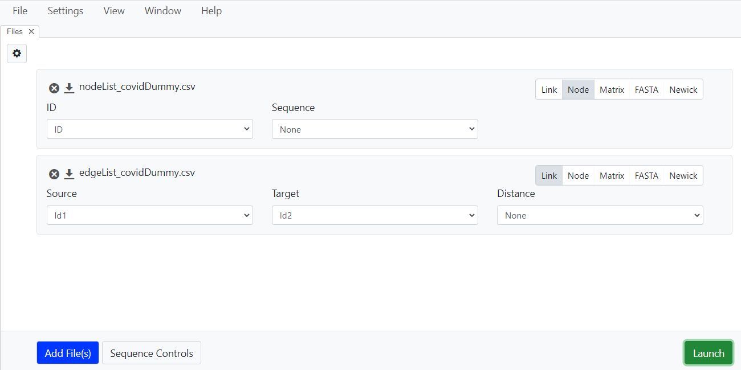
Accessing MicrobeTrace and loading files Tutorial: https://youtu.be/QWFdnK4IVoM
Use the add files button to load node and edge lists. You can also drag files from your folder and drop into the MicrobeTrace window.
MicrobeTrace detects the file type and highlights it in grey (circled in image).
Confirm that the file type is correct.

Slide 7
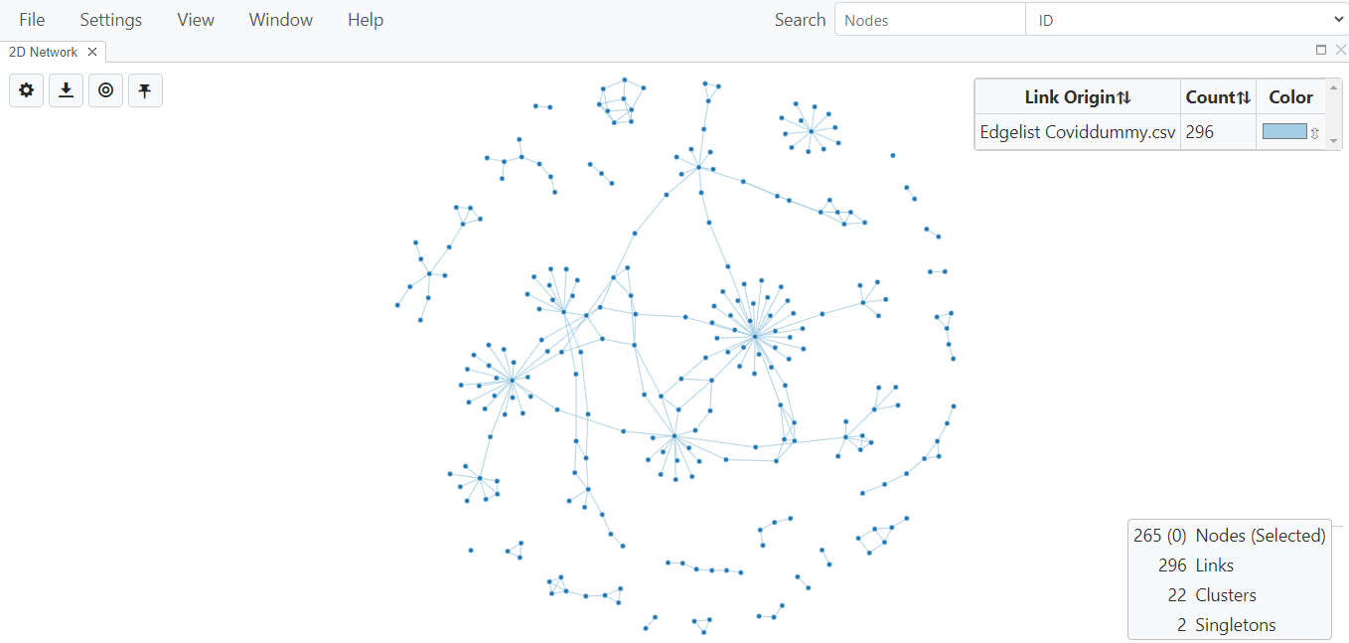
Navigating MicrobeTrace: default opening view
Main menu
Navigation elements
Link origin key
Network statistics

Slide 8
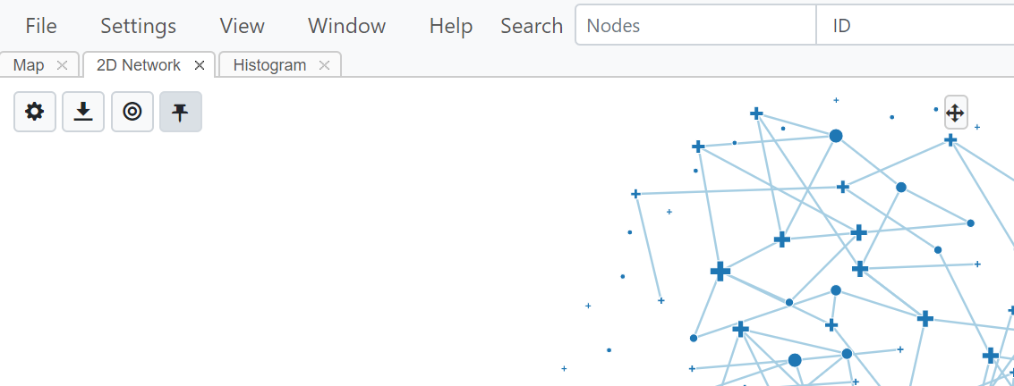
Main menu and navigation elements
The next few slides describe each of the dropdown menus available on the main menu and the 4 navigation elements (circled) available in each view.

Slide 9
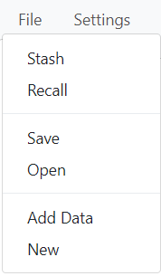
Main menu: File
Selecting File opens dropdown menu with file options.
File
Stash or Recall a session locally.
Save your work as a .microbetrace style file.
Open a saved file.
Use Add Data to add new files to your analysis.

Slide 10
Main menu: Settings
Clicking on Settings opens up the Global Settings window with 2 tabs: Filtering and Styling described in the next slide.

Slide 11
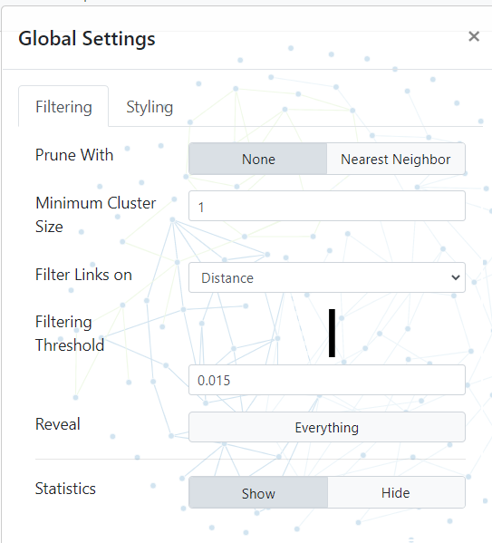
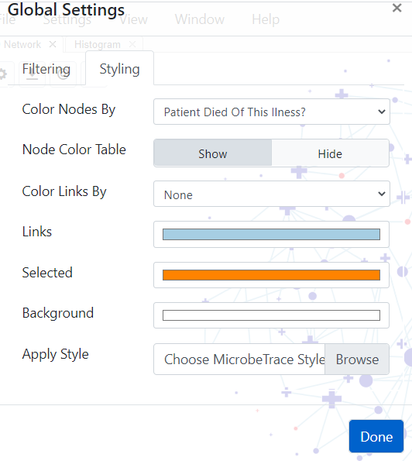
Main menu: Global Settings
Settings - filtering tab
Filter using genetic distance and nearest neighbor algorithm (if COVID sequences available)
Set minimum cluster size
Show/hide stats
Settings - styling tab
Map node and link color to demographic variables
Change background colors
Apply style parameters

Slide 12
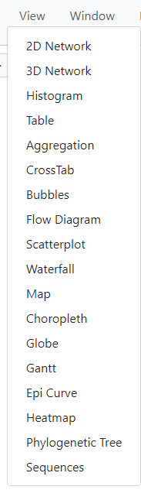
Main menu: View
Dropdown menu for choosing one of 18 views. Circled views are described in this tutorial.
Each view opens in a new tab.
Views can also be tiled - described later in the section on tiling views.

Slide 13
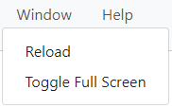
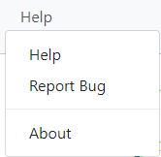
Main menu: Window and Help
Help takes you to the complete manual hosted on our GitHub site. Report a bug on the GitHub site or request feature enhancements

Slide 14
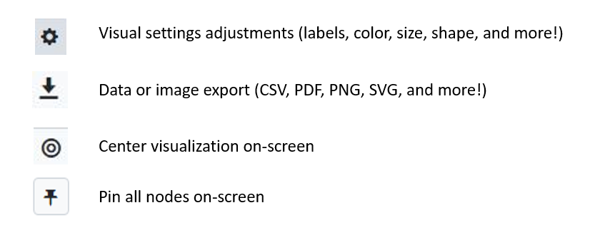
Navigation elements
On the upper-left corner of the 2D network window, as well as with other visuals, you will see the navigation elements described below.

Slide 15
2D Network view Tutorial: https://youtu.be/T5IHSveMBPY
Gear
button
Link info
Network stats
Opening view is the 2D network. Next slides describe how to change settings using the gear button

Slide 16
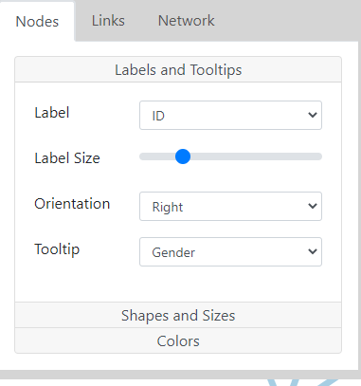
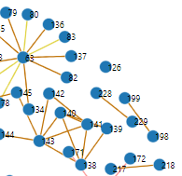
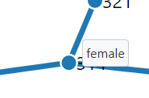
2D Network view: Labels and Tooltips
Node Labels
Nodes are labeled with IDs.
Orientation is to the right of node.
Tooltip (text displayed when you hover over a node ) is gender.
Hover mouse over node
to see gender with tooltip.

Slide 17
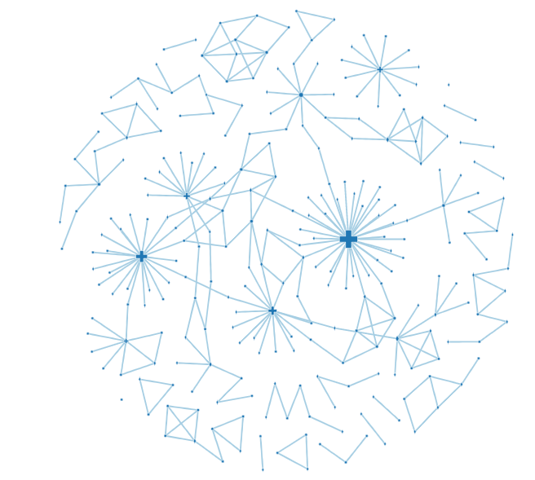
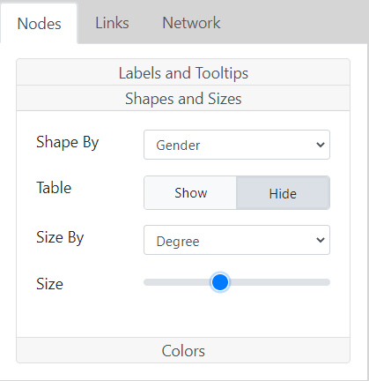
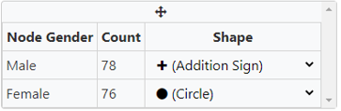
2D Network view: Shapes and Sizes
Change node sizes as needed with slider.
Nodes can be shaped by any categorical variable. In this example, we used gender.
Similarly, you can size by any variable, in this case, degree. The higher the number of connections a node (case) has, the bigger the node.
Gender stats are shown in table

Slide 18
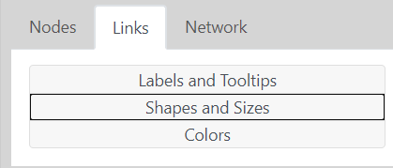
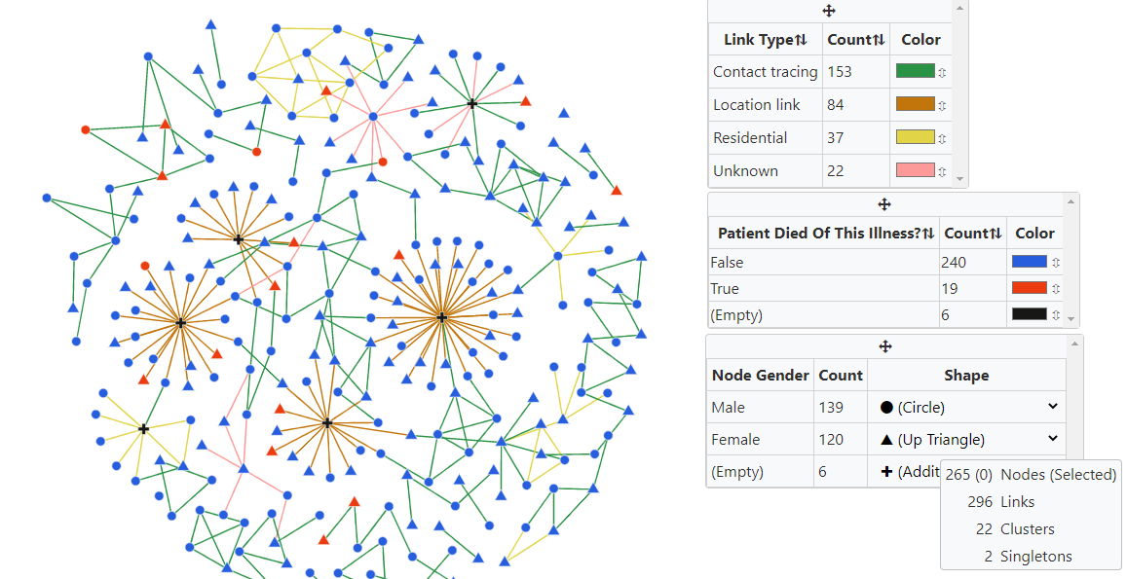
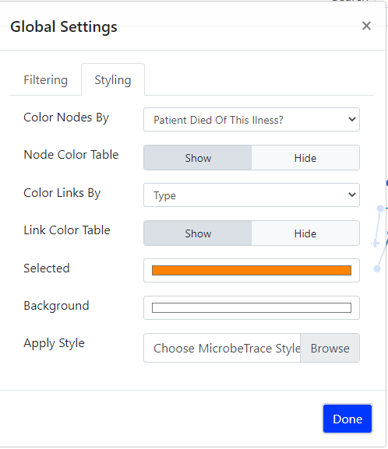
2D Network view: Colors (opens the Global Settings styling tab)
Nodes are colored by whether or not the patient died of the illness. Links are colored by type of link (i.e., person-to-person [contact tracing in blue] or person-to-place [location link in green]).
(Empty) indicates that specific data point
for some cases is not in the data set.

Slide 19
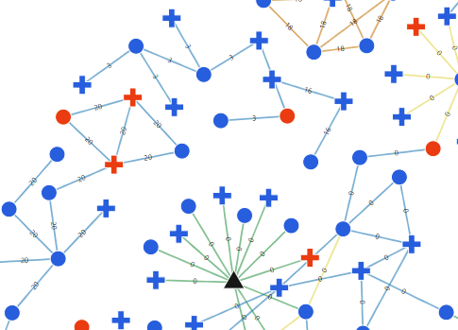
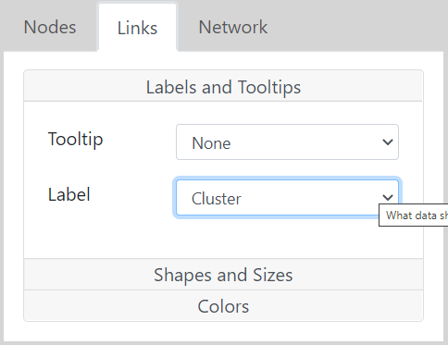
2D Network view: Links settings, Labels and Tooltips
Choose to display Links Label if desired. In this example, we selected cluster to show cluster IDs on the edge.

Slide 20
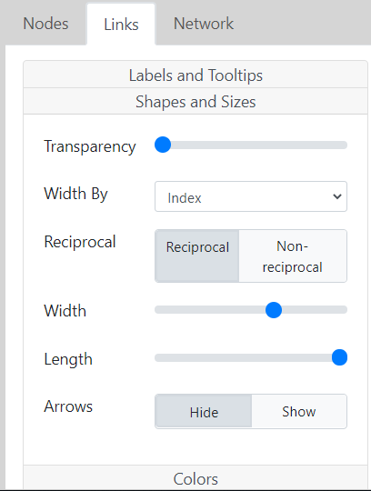
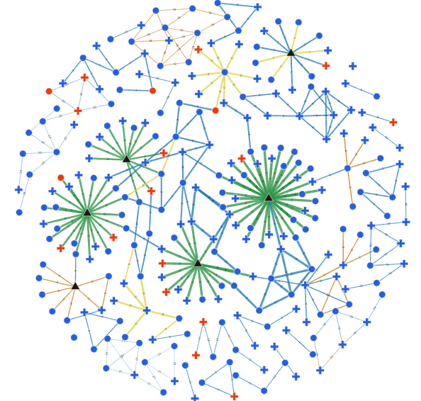
2D Network view: Links settings, Shapes and Sizes
Map width of links to any variable in the edge list (e.g., index).
Show directionality if demographic data support it.
Change link length for network clarity.

Slide 21
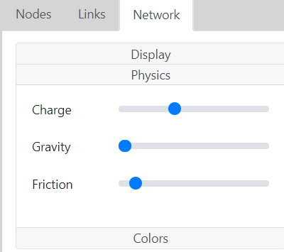
2D Network view: Network settings, Physics
Customize physical attributes (physics) of the network that push nodes away from each other or pull them closer.
Pin nodes after you adjust these to your satisfaction.

Slide 22
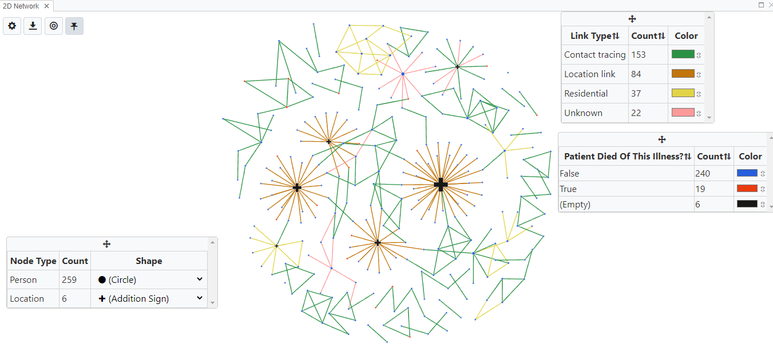
Using Network view to visualize person-to-place links
Nodes are shaped by whether they represent a person or location and sized by degree, or how many other nodes the person or place is connected to. This allows you to quickly locate hotspots and look at their relationships with case nodes.
Right click on the arrow to drag or hide the key box
A centrally placed node shows a location that is linked to many persons.

Slide 23
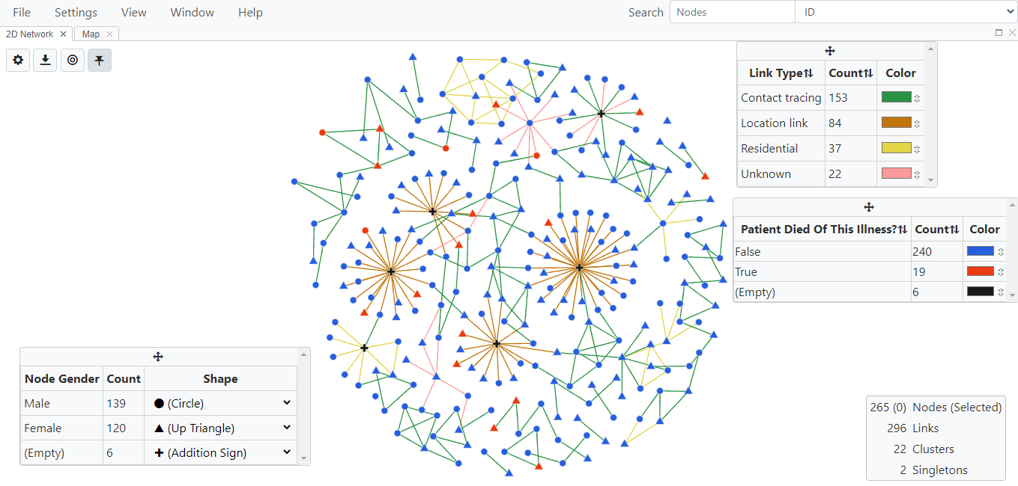
Final 2D Network View. Nodes are shaped by gender, sized by degree, and colored by whether or not cases died from illness. Links are colored by type (see key). All key boxes can be moved or hidden by right-clicking on the top panel. Link width and lengths have been increased for clarity.

Slide 24
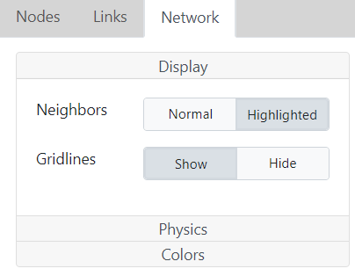
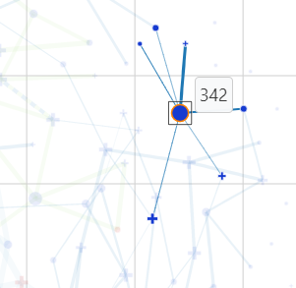
2D Network view: Network settings, Display
Customize display with neighboring nodes highlighted and background gridlines shown.

Slide 25
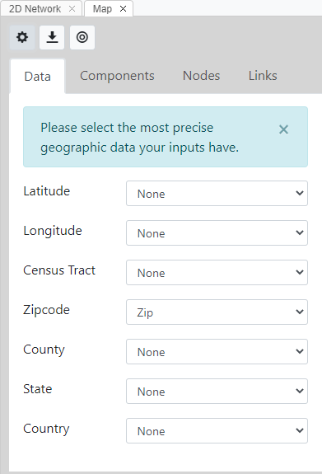
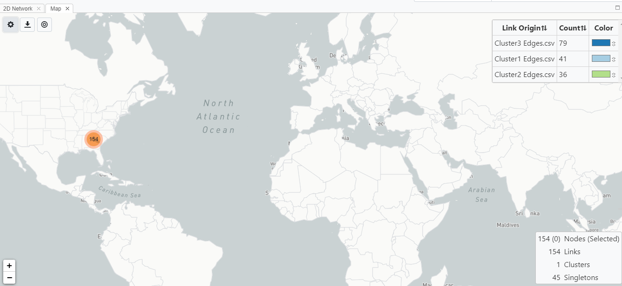
Map view: Data tab Tutorial: https://youtu.be/HqLkGqqt6cc
Nodes in the data can be displayed in a global, geographic map using map view if geo-coordinates are included in the node file. The map allows you to zoom to the geolocation indicated in the node list.
Select the most precise geo coordinates available.
Zip code is shown here.

Slide 26
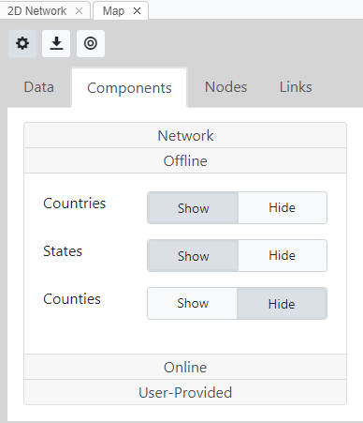
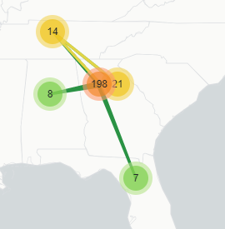
Map view settings: Components tab
If working offline, Map View is more basic.
Countries and states are shown here.

Slide 27
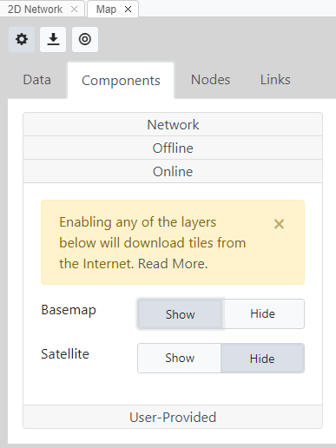
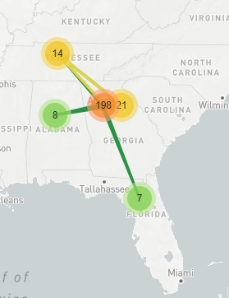
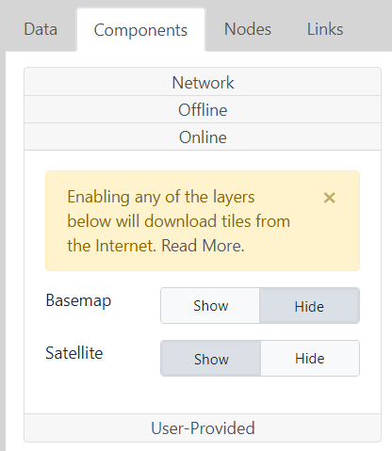
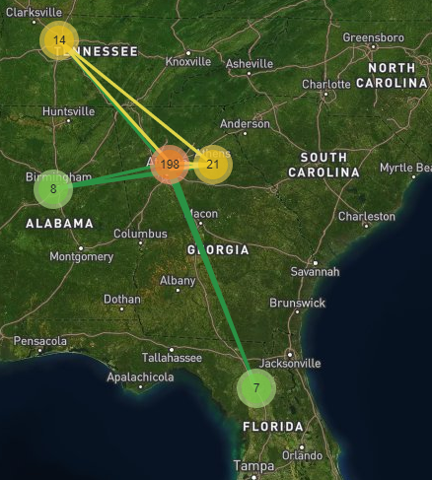
Map view settings: Components tab
Basemap enabled
If working online, MicrobeTrace downloads tiles from the internet for a more detailed map with basemap and satellite views.
Satellite enabled

Slide 28
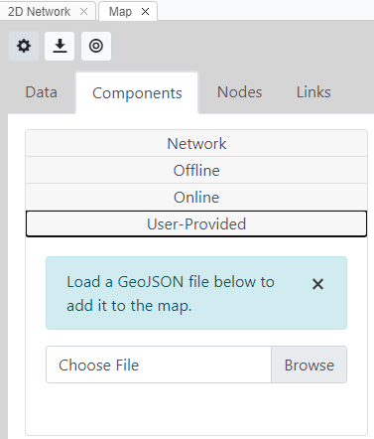
Map view settings: Components tab
Upload your own custom GeoJSON file and MicrobeTrace will render the visualization

Slide 29
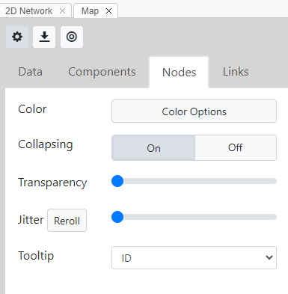
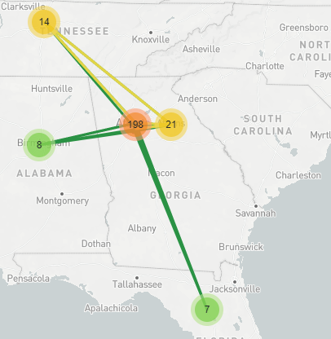
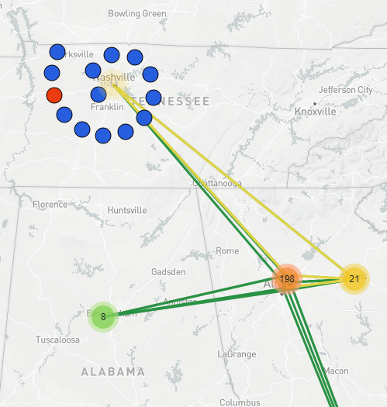
Map view settings: Nodes tab
Color Options takes you to Global Settings styling menu. Node colors from 2D network are transferred to map view.
Node collapsing is on.
Transparency of nodes is at default, so nodes are completely opaque.
Jitter is at lowest setting, so nodes may overlap.
Zoom in on the map, and click on any collapsed node (#14 in the example) to reveal component nodes in spiral.

Slide 30
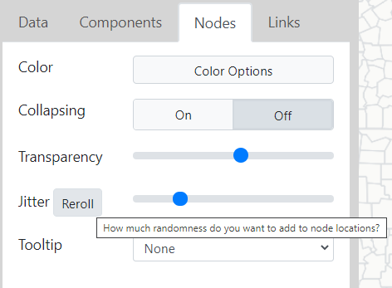
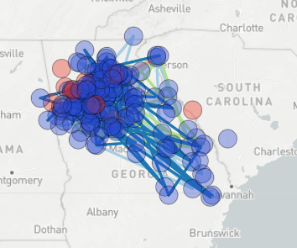
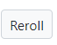
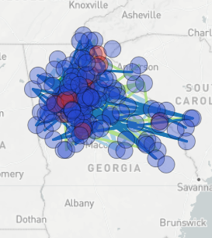
Map view settings: Nodes tab
Before Reroll
Clicking on allows nodes to be scrambled for sensitive data.
Color Options takes you to Global Settings styling menu. Node colors from 2D network are transferred to map view.
Nodes collapsing is off.
Transparency of nodes has been increased with the slider bar.
Jitter has been increased so individual nodes are visible, versus displaying a clump of overlapping nodes.
After Reroll

Slide 31
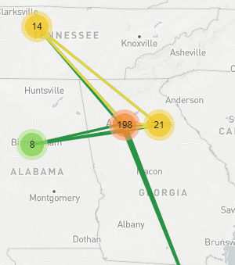
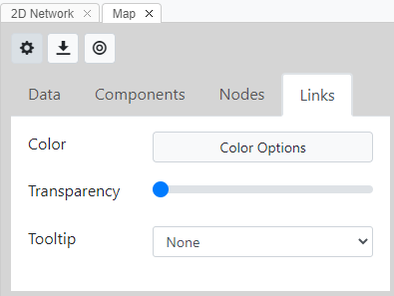
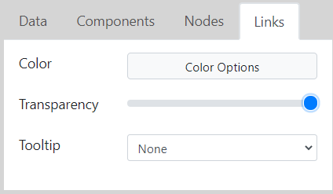

Map view settings: Links tab
Customize colors and appearance of links.
Link colors from 2D network are transferred to this view by default.
Increase transparency to maximum to hide links.

Slide 32

Final map view: Zip code, links are shown, view is zoomed. Node and link colors from the 2D network are preserved. Nodes are collapsed, but one group of 14 nodes is expanded (by clicking) to show individual nodes as a spiral.

Slide 33


Histogram view Tutorial: https://youtu.be/cs9pmL3LK_A
The histogram is a bar chart that shows the frequency of a numerical variable and can be used with contact tracing data as an alternate visualization of the relationship between variables.
Color settings from the 2D network are transferred over to this view along with the key.
Histogram of number of nodes (Y-axis) against age category (X-axis). Key shows frequencies.

Slide 34



Gantt view Tutorial: https://youtu.be/ebs2k8EkQ-c
Opening view
Used for data with time spans in the form of start and end dates.
Visualize one or more time spans for an individual and look for overlaps.
Plot the time span on the X-axis against node IDs on the Y-axis.
Can assist with resource management.
Add
dates

Slide 35



Flow view Tutorial: https://youtu.be/QZ79M8XEXag
Opening flow view
Set variables using gear menu
Final flow/alluvial diagram: diabetes as a risk factor compared to mechanical ventilation and eventual death.

Slide 36

Tiled views
Each view is opened in a new tab, but you can visualize multiple views side-by-side or in a tiled arrangement in the same window. To do this, click within a view tab and simultaneously drag it to a spot in the window either next to the currently open view or below it to create a dashboard.

Slide 37

Citing MicrobeTrace https://github.com/CDCgov/MicrobeTrace/wiki
Reporting Issues
https://github.com/CDCgov/MicrobeTRACE/issues/new
Help
microbetrace@cdc.gov

